Slide 1


GUJARAT INDUSTRIAL HACKATHON 2018
C. K. Pithawala College of Engineering and Technology, Surat
Ministry Category : PSU
Problem Statement : Driving License Controlled Smart Vehicle
Problem Code : GIH090
Mentor Name : Dr. Ami Tusharkant Choksi
Team Leader Name : Viren Chetanbhai Patel
Team ID: TG000997
​

Slide 2
Team Members
Enrolment Number | Name
160090107013 | Smit Golakiya
160090107020 | Madhav Jariwala
160090107024 | Ayush Master
160090107040 | Viren Patel
160090107045 | Saloni Agrawal
160090107055 | Manthan Solanki
160090107057 | Jahnvi Trivedi
160094107003 | Dharmit Mehta
​

Slide 3
Problems faced
Underage, not holding the license become the reason of accidents.
Eligible age, unskilled driving, not holding the license become the reason of accidents.
Crime rate increases, because of unauthorised person driving the vehicle.
Other than Person verifying the license can drive.
If Driving license is lost, vehicle can not start.

Slide 4




NFC Smart card reader scans smart driving license
Idea/ Solution
Smart driving license verification:
Fingerprint from driving license
Fingerprint from fingerprint reader
Fingerprint match checking
Ignition starts if fingerprint match

Slide 5
Idea/ Solution
At a time interval of 5 min, driving person is verified using face recognition.

Slide 6




If driving license is lost,
Backup System
(without license Card)
Open application in mobile
Connect mobile to the system
Send fingerprint via application
Fingerprint for authentication
Ignition starts if fingerprint match

Slide 7
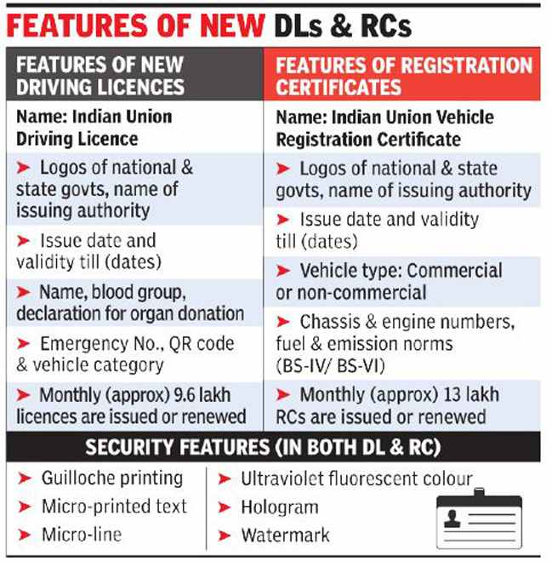
New Driving License Rule
Reference Link:
https://timesofindia.indiatimes.com/india/driving-licences-to-be-uniform-across-india/articleshow/66199699.cms

Slide 8
Hardware Stack
Smart Card Reader/RFID Reader
Arduino UNO
Fingerprint Reader
Mobile phone(Android)
Camera

Slide 9
Dependencies/ Showstopper
Dependencies :
Keep driving license or Mobile Phone
Showstopper :
Finger print module is installed to assure that unauthorized person can’t access the vehicle.

Slide 10
Estimate Cost
Arduino UNO R3 : 530 ₹
R307 fingerprint scanner: 1357 ₹
EM-18 RFID Reader: 610 ₹
Camera: 500 ₹
Total Cost ~ 3000 ₹

Slide 11
Thank You

